Slide 1

Thermal Baths as Quantum Resources: More Friends than Foes?
Gershon Kurizki
A bath may promote quantumness, work, cooling upon controlling system-bath interactions.
Taipei LII

Slide 2
Open systems everywhere
If you can’t fight the bath – join it!
or: How I learnt to stop worrying and love the bath.
Act within bath memory time:
Engineer system coupling to guided bath modes
Select bath spectra: control of two-bath machines.
Coherence/entanglement/diagnostic control | Thermodynamic control
Nature 405, 546 (2000) | Nature 452, 724 (2008)
Phys. Rev. Lett. 87, 270405 (2001) | New J. Phys. 11 123025 (2009)
Phys. Rev. Lett. 93, 130406 (2004) | New J. Phys. 12 053033 (2010)
Phys. Rev. Lett. 104 040401 (2010) | Phys. Rev. Lett. 105, 160401 (2010)
Phys. Rev. Lett. 106 010404 (2011) | Phys.Rev. Lett. 109 090601 (2012)
Phys. Rev. Lett. 106 120404 (2011) | EPL 103 60005 (2013)
Phys. Rev. Lett. 107 010404 (2011) | Phys. Rev. E 90, 022102 (2014)
Nature 480, 219 (2011) | Sci. Repts. 5 (2015)
Phys. Rev. Lett. 108 140403 (2012) | Phys. Rev. A 91, 023431 (2015)
PNAS 109, 5958 (2012) | Adv. Atom. Mol. Opt. Phys. 64,329 (2015)
PNAS 111, 10485 (2014)
Opt. Lett. 39, 3674 (2014)
New J. Phys. 16 065021 (2014) Phys.Rev.Appl. 5,014007(2016)

Slide 3
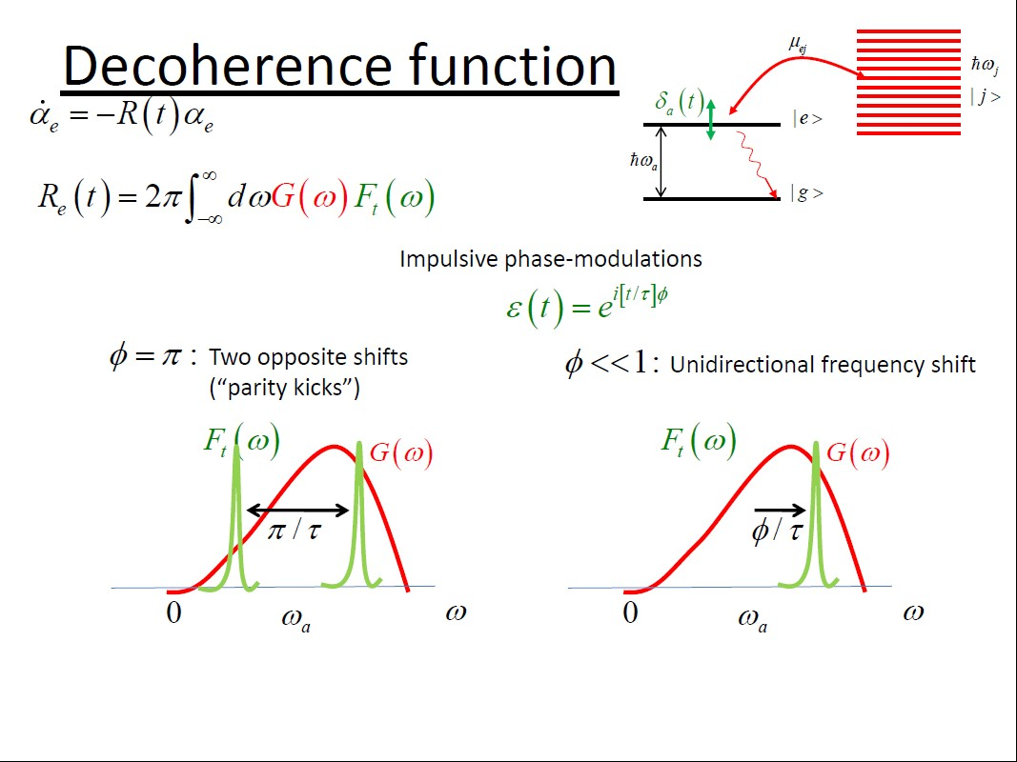
Go
Goal B
Goal C
Goal D
Goal E
Summary
I. Decoherence Control
Ia. Single spin probe

Slide 4
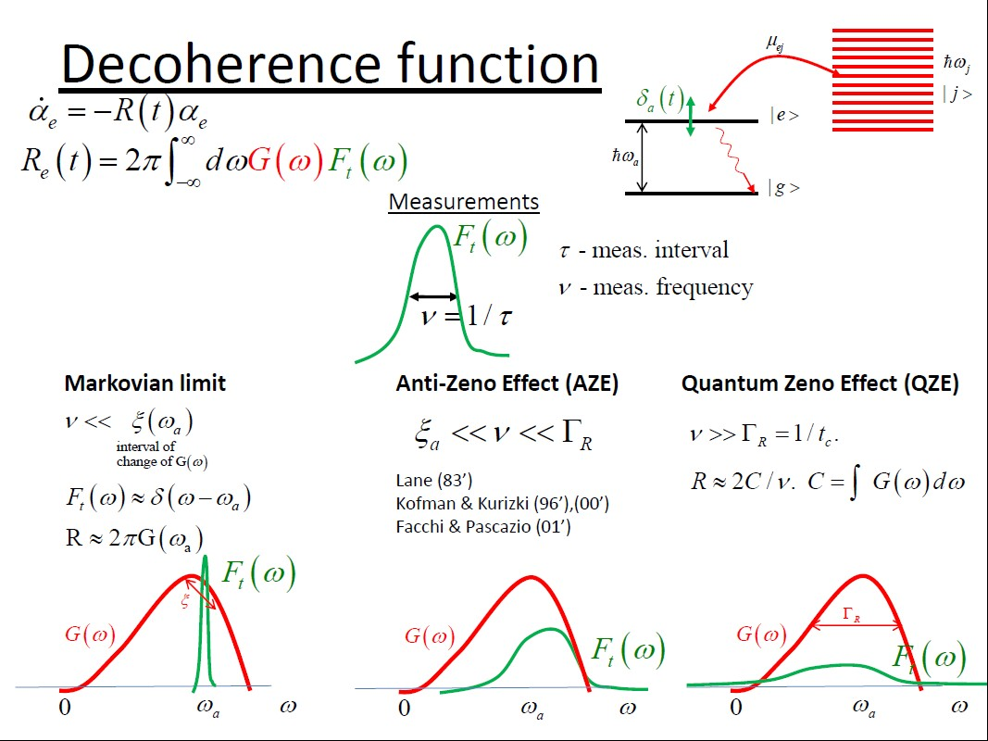
Goal A
Goal B
Goal C
Goal D
Goal E
Summary
Decoherence Control

Slide 5
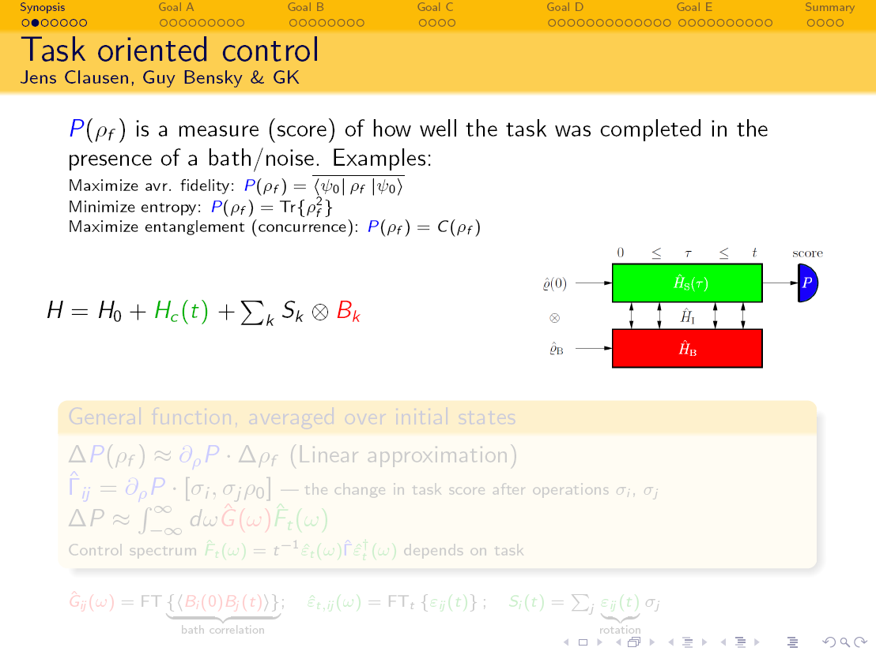

Slide 6
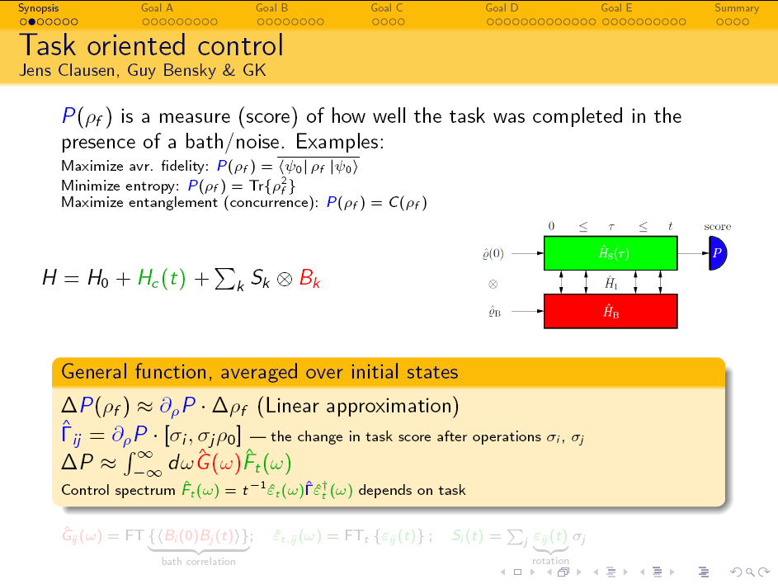
PRL 104; 040401 (2010); PRA 85, 052105 (2012)

Slide 7
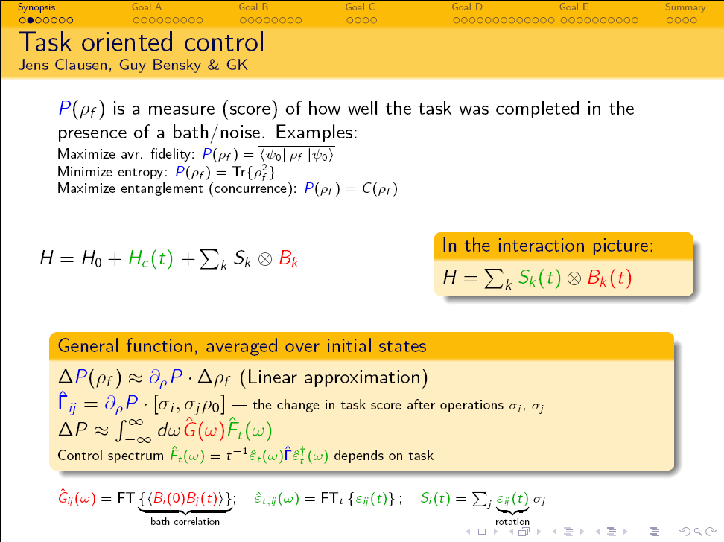
Universal task-optimized control
Jens Clausen, Guy Bensky & G.K. PRL 104; 040401 (2010); PRA 85, 052105 (2012)
Optimize under energy constraint

Slide 8
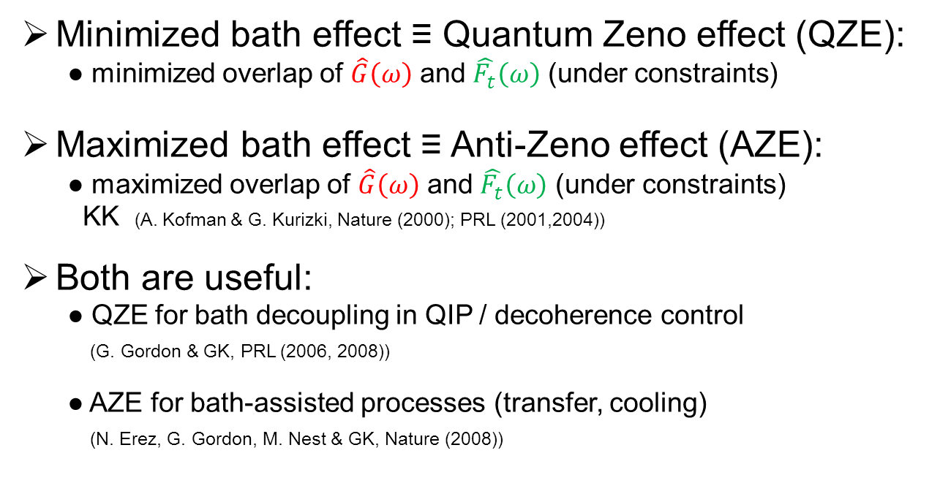
Universal paradigms of open-system control
Minimized bath effect ≡ Quantum Zeno effect (QZE):
● minimized overlap of $\hat{G}\left(ω\right)$ and $\hat{F_{t}}\left(ω\right)$ (under constraints)
Maximized bath effect ≡ Anti-Zeno effect (AZE):
● maximized overlap of $\hat{G}\left(ω\right)$ and $\hat{F_{t}}\left(ω\right)$ (under constraints)
KK (A. Kofman & G. Kurizki, Nature (2000); PRL (2001,2004))
Both are useful:
● QZE for bath decoupling in QIP / decoherence control
(G. Gordon & GK, PRL (2006, 2008))
● AZE for bath-assisted processes (transfer, cooling)
(N. Erez, G. Gordon, M. Nest & GK, Nature (2008))

Slide 9
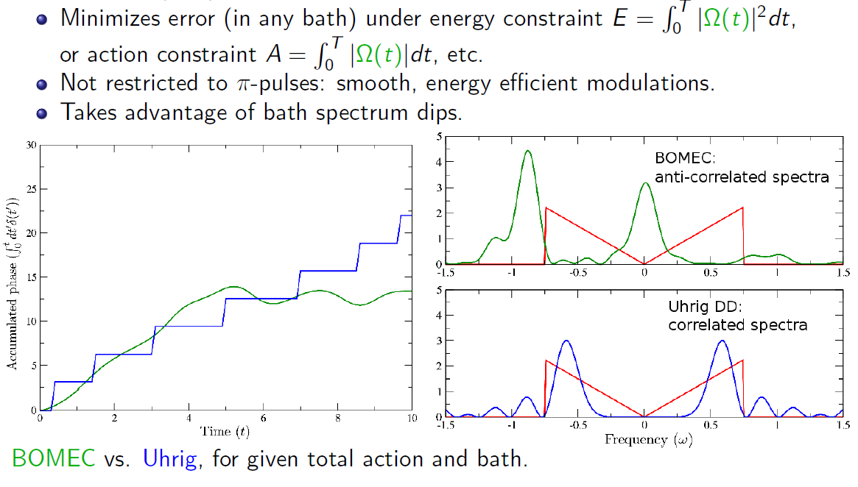
Ia. Single spin probe
Bath-optimized minimal-energy control (BOMEC)
Euler-Lagrange Optimal Modulation: G. Gordon, D. Lidar & GK (PRL, 2008)
J. Clausen, G. Bensky & GK, PRL 104 040401 (2010)
Zeno
anti-Zeno
(inadvertently)

Slide 10
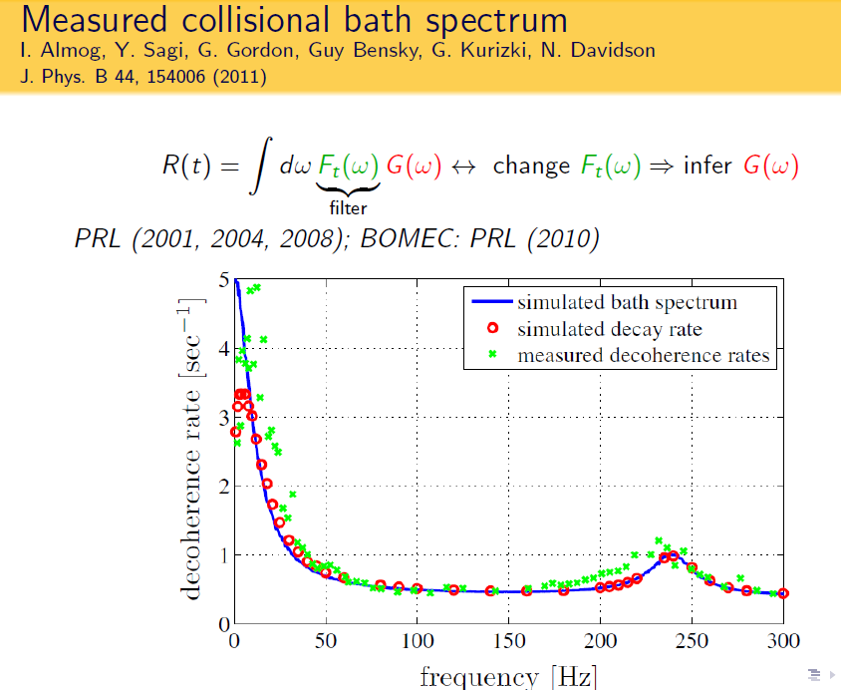
Bath diagnostics
KK (Kofman & Kurizki) universal formula, PRL (2001, 2004)

Slide 11
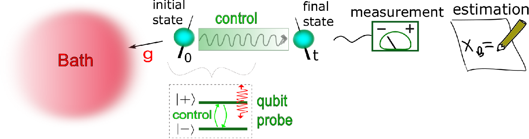

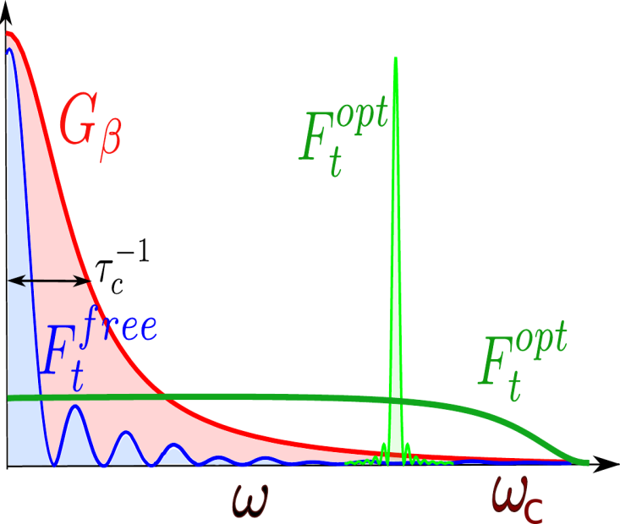





Maximizing information on the environment by
dynamically controlled qubit probes
Ultimate precision bound
Quantum Fisher Information
Signal vs Sensitivity
A. Zwick, G.A. Alvarez and G. Kurizki, Phys. Rev. Applied 5 014007 (2016)
Notes:
11

Slide 12
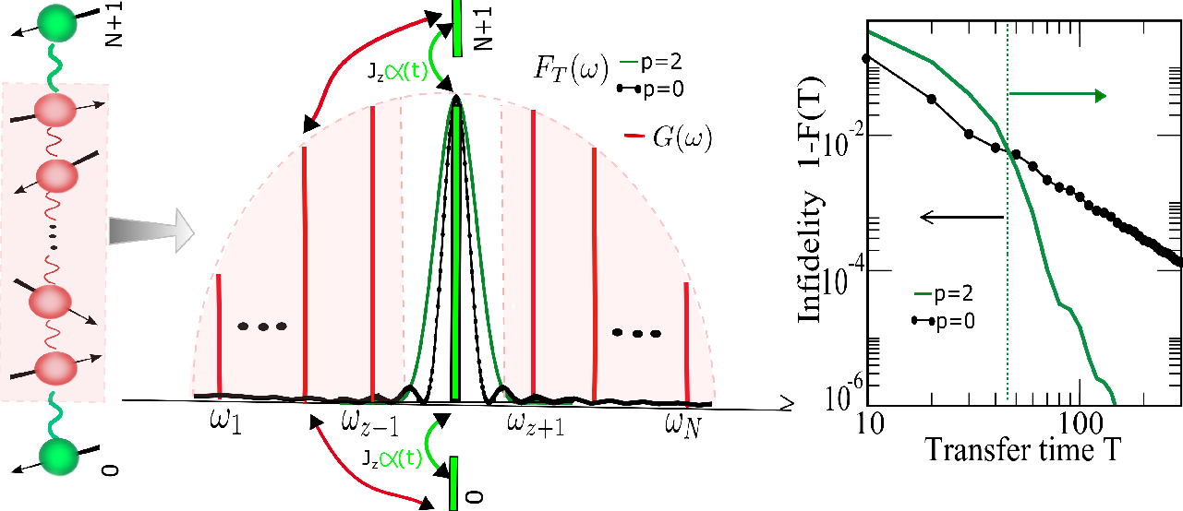


How to optimize state transfer through quantum channels
with minimal control? Boundary dynamical-control
p = 0, 2
Coupling spectrum function
Filter function
A. Zwick, G.A. Alvarez, G. Bensky and G. Kurizki, NJP 16, 065021 (2014)
Notes:
12

Slide 13
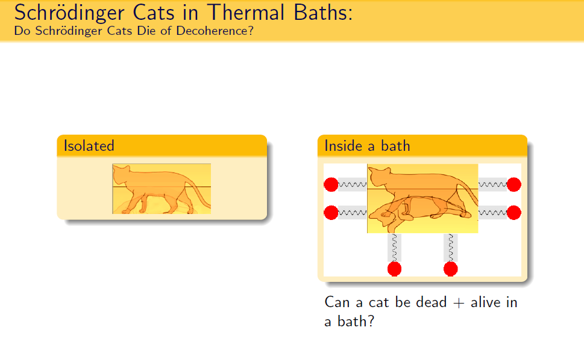
Ib. Multispin systems

Slide 14
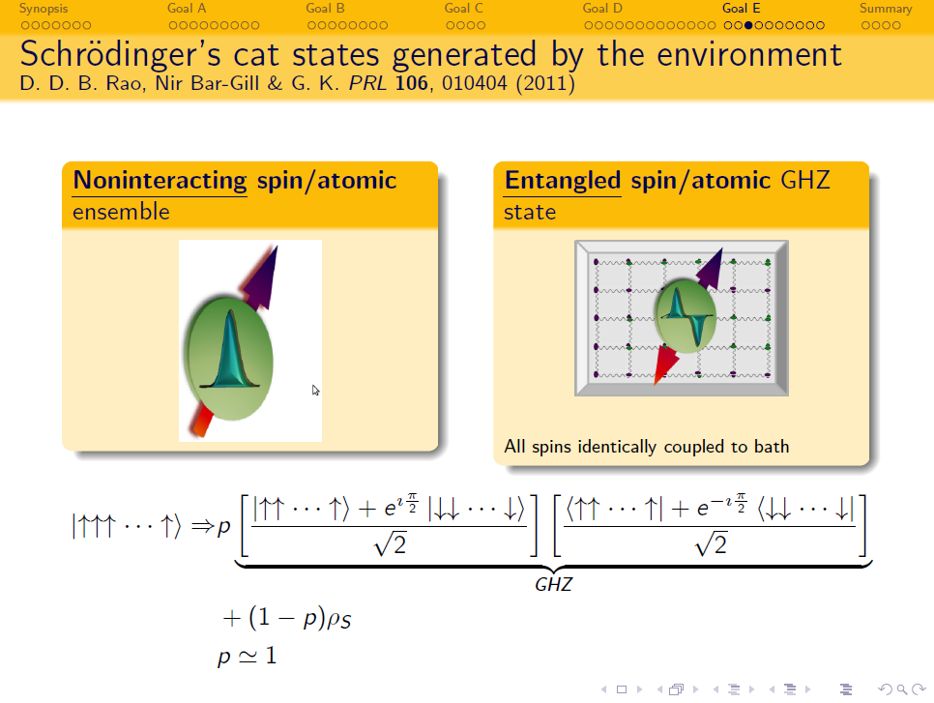

Slide 15
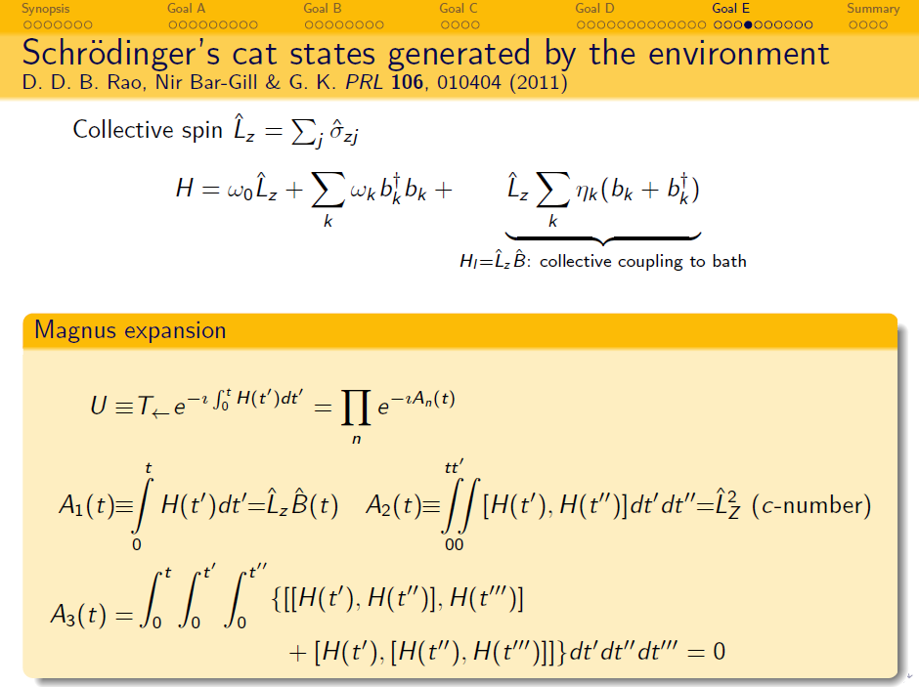

Slide 16
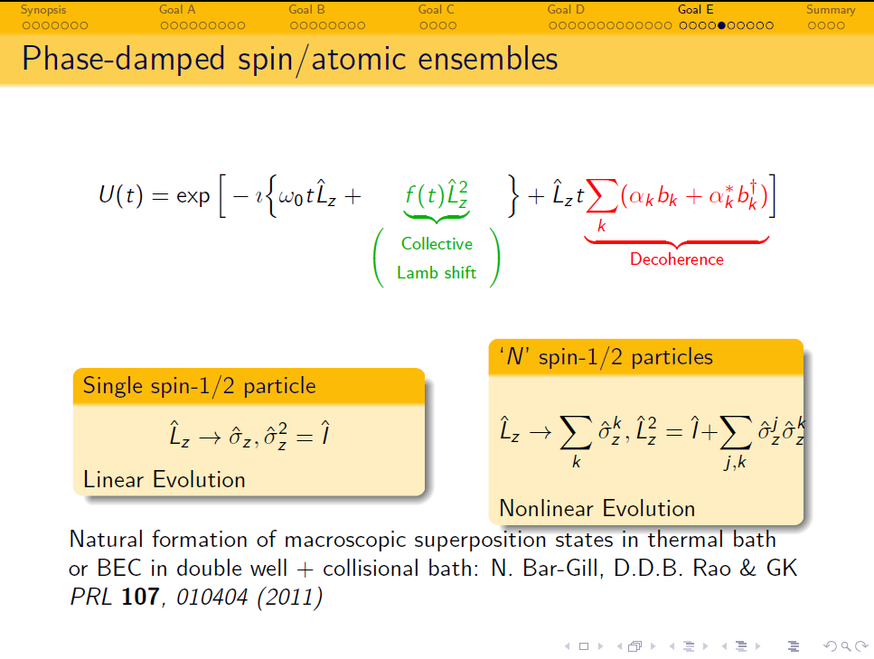

Slide 17
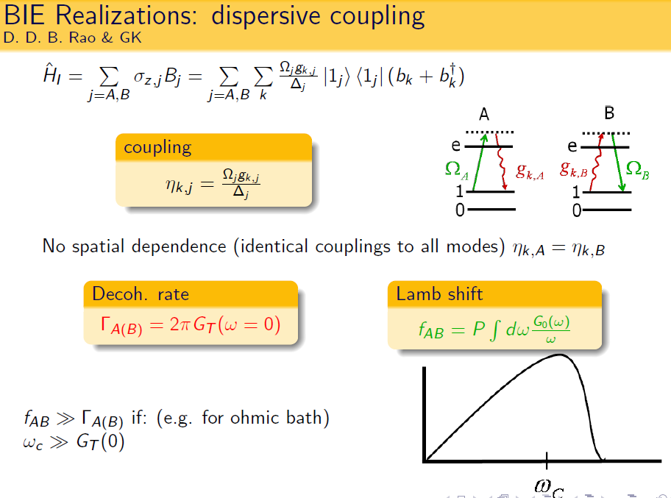
Virtual quanta exchange
Real quanta
Virtual quanta

Slide 18
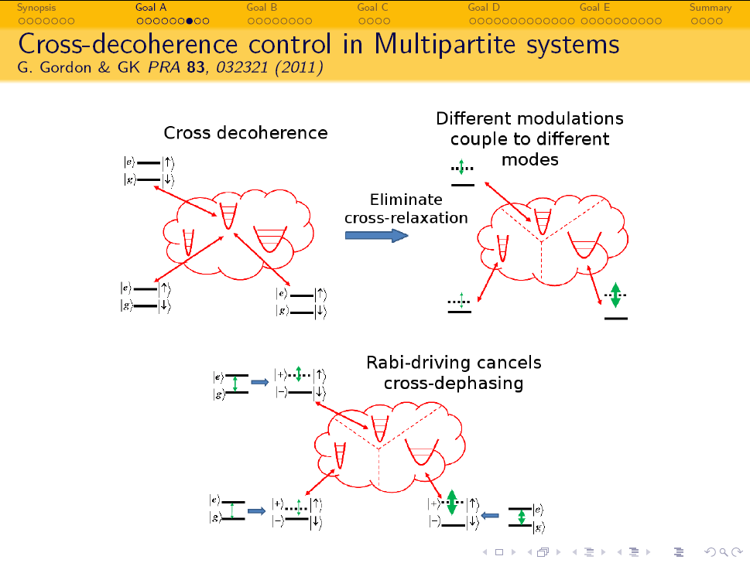
II. Entanglement control
Real quanta
Globally-incoherent (local) control of entanglement

Slide 19
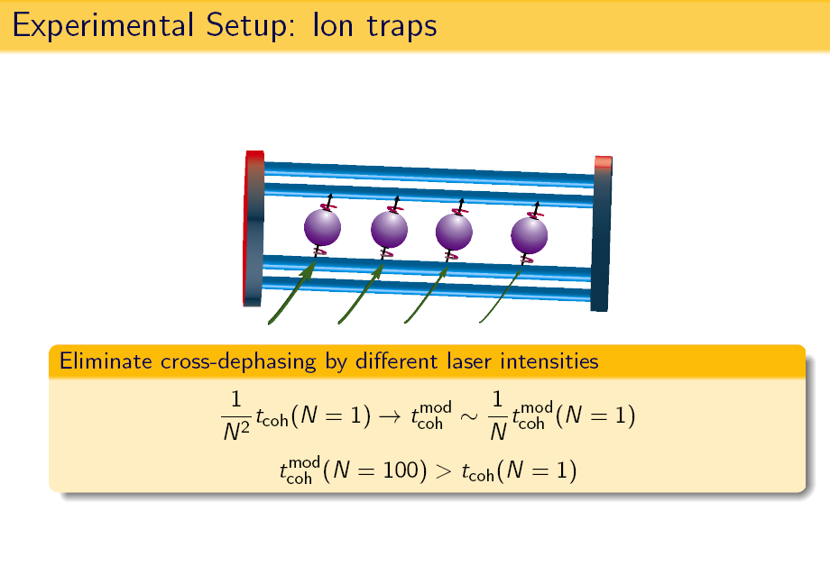
Entanglement protection by incoherent control

Slide 20
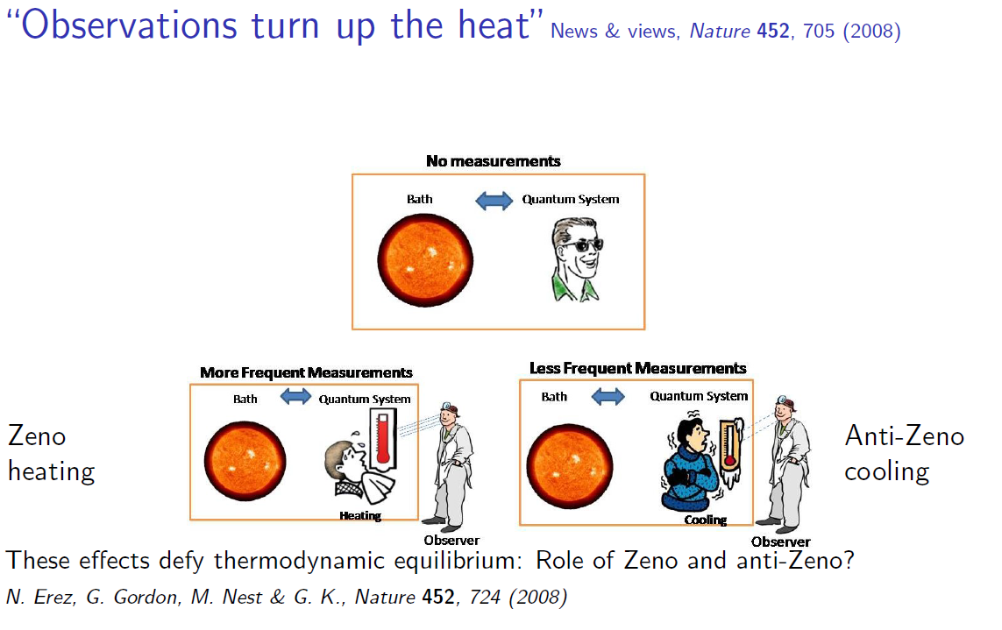
Measurement of a qubit in a bath breaks equilibrium
N. Erez et al., Nature 452, 724 (2008); G. Gordon et al., NJP 11, 123 025 (2009)
G. Alvarez, et al. PRL 104 040401 (2010)

Slide 21
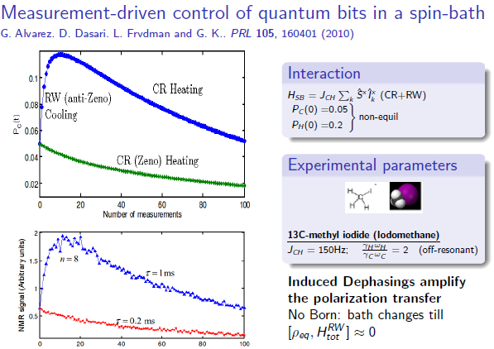

Slide 22
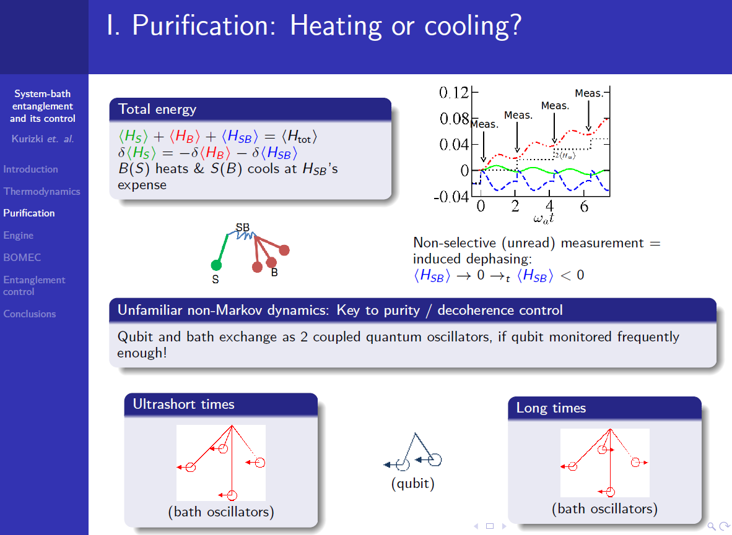

Slide 23
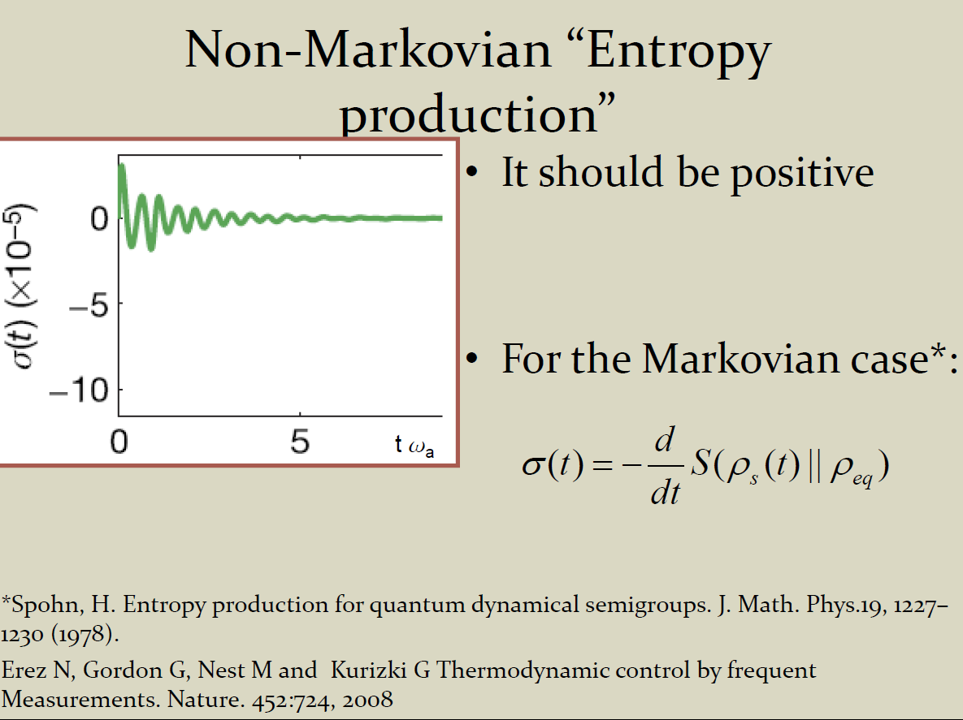

Slide 24
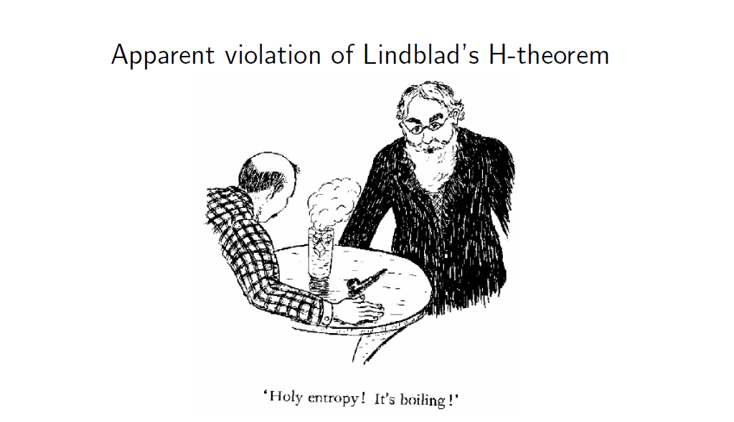
Non-selective measurements disturb
thermodynamic equilibrium
Extracting work via (non-selective) measurements:
Demented Maxwell’s demon, but bath has memory!

Slide 25
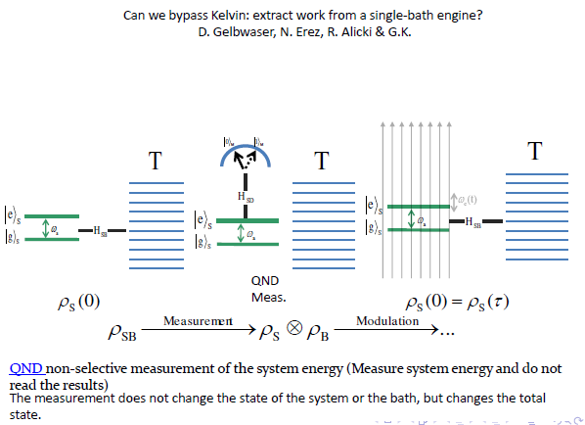
Phys. Rev. A 88, 022112 (2013)

Slide 26
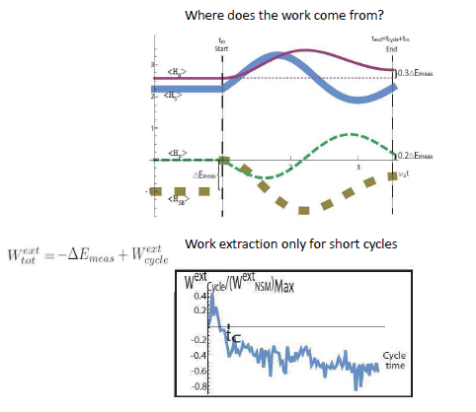

Slide 27
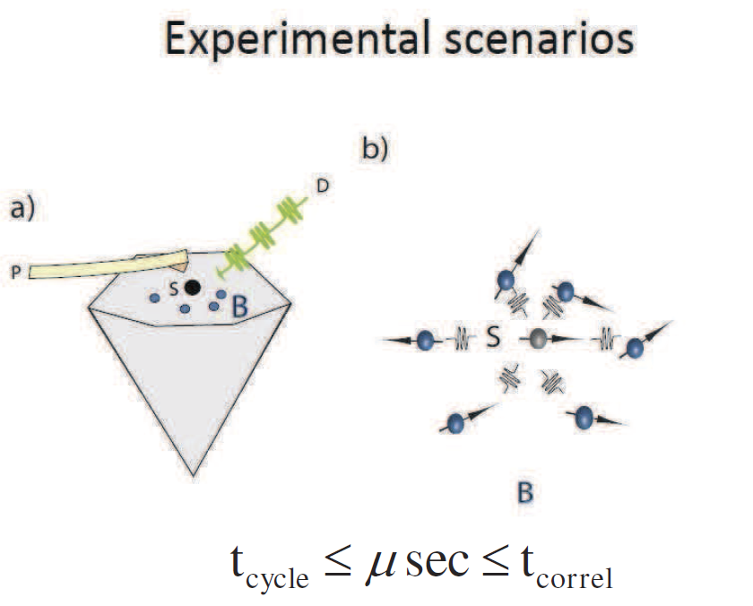

Slide 28
Summary
Task-Optimal Control:
Know thine enemy: measure noise/bath spectra universal formula
Relevant time-scale:
Not decoherence rate, only correlation time of bath
Multipartite systems
Disentanglement control
Optimize quantum logic gates
Spin-chain transfer: as in bath control
System-bath entanglement control: temp. control

